Slide 1


CMPE 180-92 Data Structures and Algorithms in C++ November 30 Class Meeting
Department of Computer Engineering San Jose State University Fall 2017 Instructor: Ron Mak
www.cs.sjsu.edu/~mak

Slide 2
Assignment #12: Extra Credit
Modify file SortTests.cpp to record the sorting statistics in instances of this struct:
struct Stats
{
long move_count;
long compare_count;
long elapsed_ms;
};

Slide 3
Assignment #12: Extra Credit, cont’d
Store the struct instances in a “three dimensional map”:
typedef map<string, map<int, map<string, Stats>>> StatsMap;
Data generator name
“Unsorted random”
“Already sorted”
“Reverse sorted”
“All zeros”
Data size
Sorting algorithm name
“Selection sort”
“Insertion sort”
“Shellsort suboptimal”
“Shellsort optimal”
“Quicksort suboptimal”
“Quicksort optimal”
“Mergesort”
Stats stats;
StatsMap stats_map;
...
stats_map[generator_name][n][sorter->name()] = stats;

Slide 4
Assignment #12: Extra Credit, cont’d
Run the sorting algorithms with data size N = 10,000 to 100,000 by increments of 10,000.
Output the stored stats as comma-separated values (CSV) and copy into text file stats.csv with column headers. Open the file with Excel.
Moves: Unsorted random
N,Selection,Insertion,Shell Sub,Shell Opt,Quick Sub,Quick Opt, Merge
10000,19980,24743369,209775,208781,91704,104618,150526
20000,39978,99248464,496880,512315,190888,218234,320901
30000,59986,223662787,745760,792562,293236,334760,498479
40000,79982,402835573,1160168,1099597,400818,454202,681667
50000,99970,627376797,1559713,1493082,509092,572150,868016
60000,119986,902496559,1760544,2068466,620352,695636,1057385
70000,139976,1221025827,2192555,2372181,724066,818264,1248891
80000,159974,1603609322,2729890,2543970,846812,943912,1443544
90000,179984,2021919155,3182741,3208782,960306,1073462,1639240
100000,199980,2502725426,3806995,3505466,1056514,1194464,1836312

Slide 5
How to Chart with Excel
In Excel, select the values you want to graph and use the main menu: Insert ➔ Chart ➔ X Y (Scatter)
Right-click the graph: Select Data ...
Click on a dot and right-click: Add Trendline
Select Polynomial with order 2 (or higher).
Save the spreadsheet as an Excel Workbook with suffix .xlsx
Otherwise, you lose the graphs.

Slide 6
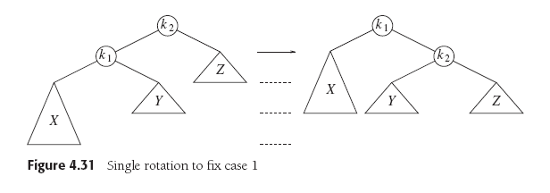
Assignment #13 Part 1 Solution
Case 1 (outside left-left): Rebalance with a single right rotation.
Data Structures and Algorithm
Analysis in C++, 4th ed.
by Mark Allen Weiss
Pearson Education, Inc., 2014

Slide 7
Assignment #13 Part 1 Solution, cont’d
/**
* Case 1 (outside left-left): Rebalance with a single right rotation.
* Update heights and return the new root node.
* @param k2 pointer to the node to rotate.
* @return pointer to the new root node.
*/
BinaryNode *AvlTree::singleRightRotation(BinaryNode *k2)
{
BinaryNode *k1 = k2->left;
// Rotate.
k2->left = k1->right;
k1->right = k2;
// Recompute node heights.
k2->height = (max(height(k2->left), height(k2->right)) + 1);
k1->height = (max(height(k1->left), k2->height) + 1);
return k1;
}
Data Structures and Algorithm
Analysis in C++, 4th ed.
by Mark Allen Weiss
Pearson Education, Inc., 2014

Slide 8
Assignment #13 Part 1 Solution, cont’d
Case 4 (outside right-right): Rebalance with a single left rotation.
Data Structures and Algorithm
Analysis in C++, 4th ed.
by Mark Allen Weiss
Pearson Education, Inc., 2014

Slide 9
Assignment #13 Part 1 Solution, cont’d
/**
* Case 4 (outside right-right): Rebalance with a single left rotation.
* Update heights and return the new root node.
* @param k2 pointer to the node to rotate.
* @return pointer to the new root node.
*/
BinaryNode *AvlTree::singleLeftRotation(BinaryNode *k1)
{
BinaryNode *k2 = k1->right;
// Rotate.
k1->right = k2->left;
k2->left = k1;
// Recompute node heights.
k1->height = (max(height(k1->left), height(k1->right)) + 1);
k2->height = (max(height(k2->right), k1->height) + 1);
return k2;
}
Data Structures and Algorithm
Analysis in C++, 4th ed.
by Mark Allen Weiss
Pearson Education, Inc., 2014

Slide 10
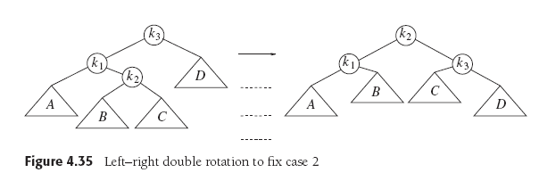
Assignment #13 Part 1 Solution, cont’d
Case 2 (inside left-right): Rebalance with a double left-right rotation.
Data Structures and Algorithm
Analysis in C++, 4th ed.
by Mark Allen Weiss
Pearson Education, Inc., 2014

Slide 11
Assignment #13 Part 1 Solution, cont’d
/**
* Case 2 (inside left-right): Rebalance with a double left-right rotation.
* @param k3 pointer to the node to rotate.
* @return pointer to the new root node.
*/
BinaryNode *AvlTree::doubleLeftRightRotation(BinaryNode *k3)
{
k3->left = singleLeftRotation(k3->left);
return singleRightRotation(k3);
}
Data Structures and Algorithm
Analysis in C++, 4th ed.
by Mark Allen Weiss
Pearson Education, Inc., 2014

Slide 12
Assignment #13 Part 1 Solution, cont’d
Case 3 (inside right-left): Rebalance with a double right-left rotation.
Data Structures and Algorithm
Analysis in C++, 4th ed.
by Mark Allen Weiss
Pearson Education, Inc., 2014

Slide 13
Assignment #13 Part 1 Solution, cont’d
/**
* Case 3 (inside right-left): Rebalance with a double left rotation.
* @param k1 pointer to the node to rotate.
* @return pointer to the new root node.
*/
BinaryNode *AvlTree::doubleRightLeftRotation(BinaryNode *k1)
{
k1->right = singleRightRotation(k1->right);
return singleLeftRotation(k1);
}
Data Structures and Algorithm
Analysis in C++, 4th ed.
by Mark Allen Weiss
Pearson Education, Inc., 2014

Slide 14
Assignment #13 Part 2 Solution

Slide 15
Assignment #13 Part 2 Solution, cont’d

Slide 16
Assignment #13 Part 2 Solution, cont’d

Slide 17
Graphs
A graph is one of the most versatile data structures in computer science.

Slide 18
Uses of Graphs
Model connectivity in computer and communications networks.
Represent a map of locations and distances between them.
Model flow capacities in transportation networks.
Find a path from a starting condition to a goal condition.
Model state transitions in computer algorithms.
Model an order for finishing subtasks in a complex activity.
Model relationships such as family trees, business and military organizations, and scientific taxonomies.

Slide 19
Graph Terms
A graph G = (V, E) is a set of vertices V and a set of edges (arcs) E.
An edge is a pair (v, w), where v and w are in V.
If the pair is ordered, the graph is directed and is called a digraph.

Slide 20
Graph Terms, cont’d
Vertex w is adjacent to vertex v if and only if (v, w) is in E.
In an undirected graph, both (v, w) and (w, v) are in E.
v is adjacent to w, and w is adjacent to v.
An edge can have a weight or cost component.

Slide 21
Graph Examples
FIGURE 12-3 Various undirected graphs
FIGURE 12-4 Various directed graphs
Data Structures Using C++
by D.S. Malik
Course Technology, 2010

Slide 22
Graph Terms, cont’d
A path is a sequence of vertices w₁, w₂, w₃, ..., w_{N} where (w_{i}, w_{i+1}) is in E, for 1 ≤ i < N.
The length of the path is the number of edges on the path.
A simple path has all distinct vertices, except that the first and last can be the same.

Slide 23
Graph Terms, cont’d
A cycle in a directed graph is a path of length ≥ 1 where w₁ = w_{N}.
A directed graph with no cycles is acyclic.
A DAG is a directed acyclic graph.
Data Structures and Algorithm
Analysis in C++, 4th ed.
by Mark Allen Weiss
Pearson Education, Inc., 2014

Slide 24
Graph Terms, cont’d
The indegree of a vertex v is the number of incoming edges (u, v).

Slide 25
Graph Representation
Represent a directed graph with an adjacency list.
For each vertex, keep a list of all adjacent vertices.
Data Structures and Algorithm
Analysis in C++, 4th ed.
by Mark Allen Weiss
Pearson Education, Inc., 2014

Slide 26
Topological Sort
We can use a graph to represent the prerequisites in a course of study.
A directed edge from Course A to Course B means that Course A is a prerequisite for Course B.
Data Structures and Algorithm
Analysis in C++, 4th ed.
by Mark Allen Weiss
Pearson Education, Inc., 2014

Slide 27
Topological Sort, cont’d
A topological sort of a directed graph is an ordering of the vertices such that if there is a path from v_{i} to v_{j}, then v_{i} comes before v_{j} in the ordering.
The order is not necessarily unique.
Data Structures and Algorithm
Analysis in C++, 4th ed.
by Mark Allen Weiss
Pearson Education, Inc., 2014

Slide 28
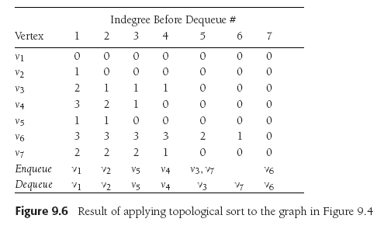
Topological Sort, cont’d
Topological sort example using a queue.
Start with vertex v₁.
On each pass, remove the vertices with indegree = 0.
Subtract 1 from the indegree of the adjacent vertices.
The topological sort is the order
in which the vertices dequeue.
Data Structures and Algorithm
Analysis in C++, 4th ed.
by Mark Allen Weiss
Pearson Education, Inc., 2014

Slide 29
Topological Sort, cont’d
Pseudocode to perform a topological sort.
O(|E| + |V |) time
Data Structures and Algorithm
Analysis in C++, 4th ed.
by Mark Allen Weiss
Pearson Education, Inc., 2014

Slide 30
Shortest Path Algorithms
Assume there is a cost associated with each edge.
The cost of a path is the sum of the cost of each edge on the path.
Find the least-cost path from a “distinguished” vertex s to every other vertex in the graph.
Data Structures and Algorithm
Analysis in C++, 4th ed.
by Mark Allen Weiss
Pearson Education, Inc., 2014

Slide 31
Shortest Path Algorithms, cont’d
A negative cost results in a negative-cost cycle.
Make a path’s cost arbitrarily small by looping.
Data Structures and Algorithm
Analysis in C++, 4th ed.
by Mark Allen Weiss
Pearson Education, Inc., 2014

Slide 32
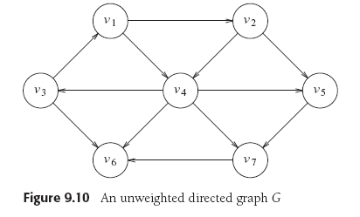
Unweighted Shortest Path
Minimize the lengths of paths.
Assign a weight of 1 to each edge.
In this example, let the distinguished vertex s be v₃.
Data Structures and Algorithm
Analysis in C++, 4th ed.
by Mark Allen Weiss
Pearson Education, Inc., 2014

Slide 33
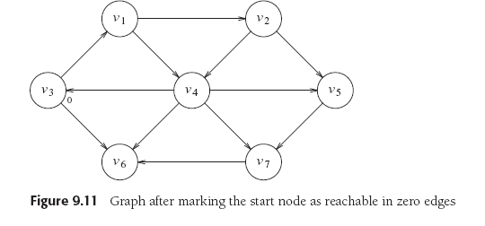
Unweighted Shortest Path, cont’d
The path from s to itself has length (cost) 0.
Data Structures and Algorithm
Analysis in C++, 4th ed.
by Mark Allen Weiss
Pearson Education, Inc., 2014

Slide 34
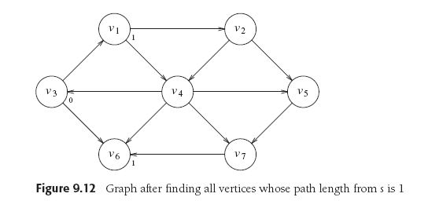
Unweighted Shortest Path, cont’d
Find vertices v₁ and v₆ that are distance 1 from v₃:
Data Structures and Algorithm
Analysis in C++, 4th ed.
by Mark Allen Weiss
Pearson Education, Inc., 2014

Slide 35
Unweighted Shortest Path, cont’d
Find all vertices that are distance 2 from v₃.
Begin with the vertices adjacent to v₁ and v₆.
Data Structures and Algorithm
Analysis in C++, 4th ed.
by Mark Allen Weiss
Pearson Education, Inc., 2014

Slide 36
Unweighted Shortest Path, cont’d
Find all vertices that are distance 3 from v₃.
Begin with the vertices adjacent to v₂ and v₄.
Now we have the shortest paths from v₃ to every other vertex.
Data Structures and Algorithm
Analysis in C++, 4th ed.
by Mark Allen Weiss
Pearson Education, Inc., 2014

Slide 37
Unweighted Shortest Path, cont’d
Keep the tentative distance from vertex v₃ to another vertex in the d_{v} column.
Keep track of the path in the p_{v} column.
A vertex becomes known after it has been processed.
Don’t reprocess a known vertex.
No cheaper path can be found.
Set all d_{v} = ∞.
Enqueue the distinquished vertex s and set d_{s} = 0.
During each iteration, dequeue a vertex v.
Mark v as known.
For each vertex w adjacent to v whose d_{w} = ∞
Set its distance d_{w} to d_{v} + 1
Set its path p_{w} to v.
Enqueue w.
Data Structures and Algorithm
Analysis in C++, 4th ed.
by Mark Allen Weiss
Pearson Education, Inc., 2014

Slide 38
Unweighted Shortest Path, cont’d
Data Structures and Algorithm
Analysis in C++, 4th ed.
by Mark Allen Weiss
Pearson Education, Inc., 2014

Slide 39
Unweighted Shortest Path, cont’d
Data Structures and Algorithm
Analysis in C++, 4th ed.
by Mark Allen Weiss
Pearson Education, Inc., 2014

Slide 40
Break

Slide 41
Weighted Least Cost Path
Dijkstra’s Algorithm
Example of a greedy algorithm.
Greedy algorithm
At each stage, do what appears to be the best at that stage.
A greedy algorithm may not always work.
Keep the same information for each vertex:
Either known or unknown
Tentative distance d_{v}
Path information p_{v}

Slide 42
Dijkstra’s Algorithm
At each stage:
Select an unknown vertex v that has the smallest d_{v}.
Declare that the shortest path from s to v is known.
For each vertex w adjacent to v:
Set its distance d_{w} to the d_{v} + cost_{v,w}
Set its path p_{w} to v.
Data Structures and Algorithm
Analysis in C++, 4th ed.
by Mark Allen Weiss
Pearson Education, Inc., 2014

Slide 43
Dijkstra’s Algorithm, cont’d
Start with s = v₁
Data Structures and Algorithm
Analysis in C++, 4th ed.
by Mark Allen Weiss
Pearson Education, Inc., 2014

Slide 44
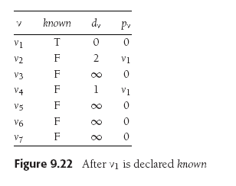
Dijkstra’s Algorithm, cont’d
Set v₁ to known.
v₂ and v₄ are unknown and adjacent to v₁:
Set d₂ and d₄ to their costs + cost of v₁
Set p₂ and p₄ to v₁.
Data Structures and Algorithm
Analysis in C++, 4th ed.
by Mark Allen Weiss
Pearson Education, Inc., 2014

Slide 45
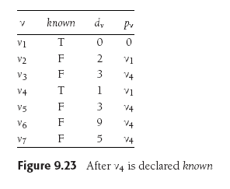
Dijkstra’s Algorithm, cont’d
d₄ was the smallest unknown. Set v₄ to known.
v₃, v₅, v₆, and v₇ are unknown and adjacent to v₄:
Set their d_{w} to their costs + cost of v₄
Set their p_{w} to v₄.
Data Structures and Algorithm
Analysis in C++, 4th ed.
by Mark Allen Weiss
Pearson Education, Inc., 2014

Slide 46
Dijkstra’s Algorithm, cont’d
d₂ was the smallest unknown. Set v₂ to known.
v₅ is unknown and adjacent:
d₅ is already 3 which is less than 2+10=12, so do not change v₅
Data Structures and Algorithm
Analysis in C++, 4th ed.
by Mark Allen Weiss
Pearson Education, Inc., 2014

Slide 47
Dijkstra’s Algorithm, cont’d
Set v₅ to known. v₇ is unknown and adjacent.
Do not adjust since 5 < 3+6.
Set v₃ to known. v₆ is unknown and adjacent.
Change d₆ to 3+5=8 which is less than its previous value of 9.
Change p₆ to v₃.
Data Structures and Algorithm
Analysis in C++, 4th ed.
by Mark Allen Weiss
Pearson Education, Inc., 2014

Slide 48
Dijkstra’s Algorithm, cont’d
Set v₇ to known. v₆ is unknown and adjacent.
Change d₆ to 5+1=6 which is less than its previous value of 8.
Change p₆ to v₇.
Data Structures and Algorithm
Analysis in C++, 4th ed.
by Mark Allen Weiss
Pearson Education, Inc., 2014

Slide 49
Dijkstra’s Algorithm, cont’d
Set v₆ to known.
The algorithm terminates.
Data Structures and Algorithm
Analysis in C++, 4th ed.
by Mark Allen Weiss
Pearson Education, Inc., 2014

Slide 50
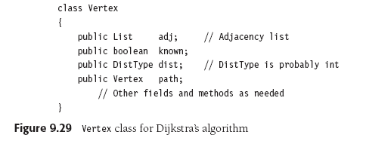
Dijkstra’s Algorithm, cont’d

Slide 51
Dijkstra’s Algorithm, cont’d

Slide 52
Dijkstra’s Algorithm, cont’d

Slide 53
Minimum Spanning Tree (MST)
Suppose you’re wiring a new house.
What’s the minimum length of wire you need to purchase?
Represent the house as an undirected graph.
Each electrical outlet is a vertex.
The wires between the outlets are the edges.
The cost of each edge is the length of the wire.

Slide 54
Minimum Spanning Tree (MST), cont’d
Create a tree formed from the edges of an undirected graph that connects all the vertices at the lowest total cost.

Slide 55
Minimum Spanning Tree (MST), cont’d
The MST
Is an acyclic tree.
Spans (includes) every vertex.
Has |V |-1 edges.
Has minimum total cost.
Data Structures and Algorithm
Analysis in C++, 4th ed.
by Mark Allen Weiss
Pearson Education, Inc., 2014

Slide 56
Minimum Spanning Tree (MST), cont’d
Add each edge to an MST in such a way that:
It does not create a cycle.
Is the least cost addition.
A greedy algorithm!
Data Structures and Algorithm
Analysis in C++, 4th ed.
by Mark Allen Weiss
Pearson Education, Inc., 2014

Slide 57
Prim’s Algorithm for MST
Rediscovered by Robert C. Prim in 1957 to solve connection network problems.
First discovered in 1930 by Czech mathematician Vojtěch Jarník.
At any point during the algorithm, some vertices are in the MST and others are not.
Choose one vertex to start.

Slide 58
Prim’s Algorithm for MST, cont’d
At each stage, add another vertex to the tree.
Choose a vertex such that:
The edge (u, v) has the lowest cost among all the edges.
u is already in the tree and v is not.
Similar to Dijkstra’s algorithm for shortest paths.
Maintain whether or not a vertex is known, and its d_{v} and p_{v} values.

Slide 59
Prim’s Algorithm for MST, cont’d
Data Structures and Algorithm
Analysis in C++, 4th ed.
by Mark Allen Weiss
Pearson Education, Inc., 2014

Slide 60
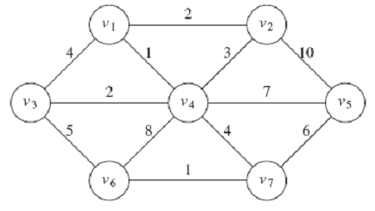
Prim’s Algorithm for MST, cont’d
Data Structures and Algorithm
Analysis in C++, 4th ed.
by Mark Allen Weiss
Pearson Education, Inc., 2014

Slide 61
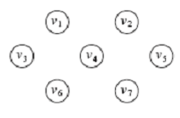
Prim’s Algorithm for MST, cont’d
Choose v₁ to start. Declare it known.
Set the d_{v} and p_{v} of v₁’s neighbors.
Data Structures and Algorithm
Analysis in C++, 4th ed.
by Mark Allen Weiss
Pearson Education, Inc., 2014

Slide 62
Prim’s Algorithm for MST, cont’d
Choose v₄ and declare it known.
Set the d_{v} and p_{v} of v₄’s neighbors
that are still unknown: v₃, v₅, v₆, and v₇.
Don’t do v₂ because d₂ = 2 < 3.
Data Structures and Algorithm
Analysis in C++, 4th ed.
by Mark Allen Weiss
Pearson Education, Inc., 2014

Slide 63
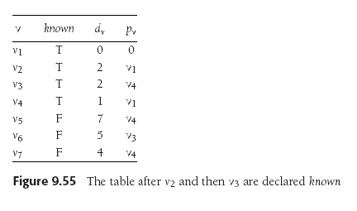
Prim’s Algorithm for MST, cont’d
Choose v₂ and declare it known.
No changes to the table.
Choose v₃ and declare it known.
Set the d_{v} and p_{v} of v₃’s neighbors
that still unknown: v₆.
Set d₆ = 5 < its previous value 8.
Data Structures and Algorithm
Analysis in C++, 4th ed.
by Mark Allen Weiss
Pearson Education, Inc., 2014

Slide 64
Prim’s Algorithm for MST, cont’d
Choose v₇ and declare it known.
Set the d_{v} and p_{v} of v₄’s neighbors
that still unknown: v₅ and v₆.
Set d₅ = 6 < its previous value 7.
Set d₆ = 1 < its previous value 5.
Data Structures and Algorithm
Analysis in C++, 4th ed.
by Mark Allen Weiss
Pearson Education, Inc., 2014

Slide 65
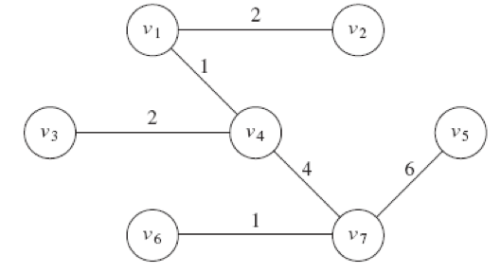
Prim’s Algorithm for MST, cont’d
Choose v₆ and declare it known.
No changes to the table.
Choose v₅ and declare it known.
No changes to the table.
Data Structures and Algorithm
Analysis in C++, 4th ed.
by Mark Allen Weiss
Pearson Education, Inc., 2014

Slide 66
Graph Traversal Algorithms
Graph traversal is similar to tree traversal.
Visit each vertex of a graph in a particular order.
Special problems for graphs:
It may not be possible to reach all vertices from the start vertex.
The graph may contain cycles.
Don’t go into an infinite loop.
“Mark” each vertex after a visit.
Don’t revisit marked vertices.

Slide 67
You’re Lost in a Maze
You have a bag of bread crumbs.
As you go down each path, you drop bread crumbs to mark your path.
Whenever you come to a dead end, you retrace your path by following your bread crumbs.
You continue retracing your path (“backtracking”) until you come to an intersection with an unmarked path.
You (recursively) go down the unmarked path.

Slide 68
Depth-First Search
Represent the maze as a graph.
Each path is an edge.
Each intersection is a vertex.
You are doing a depth-first search of the graph.

Slide 69
Depth-First Search
void dfs(Vertex v)
{
v.visited = true; // mark
for each Vertex w adjacent to v {
if (!w.visited) {
dfs(w); // recursively visit w
}
}
}
Visits each vertex once.
Processes each edge once in a directed graph.
Processes each edge from both directions in an undirected graph.
Therefore, O(|V | + |E |).

Slide 70
Depth-First Search
3
2
B
F
H
4
C
5
1
A
D
G
I
8
6
7
E
9

Slide 71
Depth-First Search and Games
Depth-first search is used by game-playing programs.
Example: IBM’s “Deep Blue” chess playing program.
Use a graph to represent the possible moves from the present situation into the future.
Each vertex is a decision point for either you or your opponent.

Slide 72
Depth-First Search and Games, cont’d
Perform a depth-first search to look at possible move outcomes of both you and your opponent.
Each edge would have the cost of going down that path.
Backtrack if a path is a dead end or its cost is not beneficial.
How deeply your program can search depends on the computer’s memory and the allowed search time.

Slide 73
Find a Lost Child in a Large Building
Start in the room where the child was last seen.
Search each room adjacent to the first room.
Put a tag on the door to mark a room you’ve already searched.
Then search each room adjacent to the rooms you’ve already searched.
Repeatedly search all the rooms adjacent to rooms you’ve already searched before moving farther out from the first room.

Slide 74
Breadth-First Search
Represent the building as a graph.
Each room is a vertex.
Each hallway between rooms is an edge.
You are doing a breadth-first search of the graph.

Slide 75
Breadth-First Search
void bfs(Vertex s)
{
Queue<Vertex> q = new Queue<>();
q.enqueue(s);
s.visited = true;
while (!q.empty()) {
Vertex v = q.dequeue();
for each Vertex w adjacent to v {
if (!w.visited) {
w.visited = true;
q.enqueue(w);
}
}
}
}

Slide 76
Breadth-First Search
2
6
B
F
H
8
C
3
1
A
4
D
G
I
9
7
E
5

